Slide 1
금융중개의 필수적 역할 김영식 (서울대 경제학부)

Slide 2
References
Diamond, Douglas W. (1984) “Financial intermediation and delegated monitoring,” Review of Economic Studies 51.
Williamson, Stephen D. (1986) “Costly monitoring, financial intermediation, and equilibrium credit rationing,” Journal of Monetary Economics 18.

Slide 3
Monitoring borrowers on behalf of lenders
Why do financial intermediaries (FI) exist?
According to Diamond (1984) and Williamson (1986), FI’s exist because they economize on the costs of monitoring borrowers in a world where relevant information about specific borrowers is not freely available to lenders.
Borrowers know more about the realized outcomes of their investment projects than do lenders.
Individual lenders delegate the responsibility for monitoring borrowers to the intermediary and thereby economize on the costs of monitoring investment outcomes.

Slide 4
Delegated monitoring of borrowers
Lenders and Entrepreneurs
In each period t where t = 1,2,3,..., there are N agents born, each of whom lives for two periods.
A fraction α of these agents are lenders and the remainder (1-α) are entrepreneurs.
Lenders born at time t are each endowed with e units of the time t consumption good in the first period of life.
To consume in the second period of life, lenders save by exchanging their endowment for some claim to the second period’s consumption good.

Slide 5
Delegated monitoring of borrowers
Lenders and Entrepreneurs
Entrepreneurs born at time t receive no endowment in either period of life.
Each entrepreneur has access to an investment project that needs K units of the consumption good to operate.
Because K is assumed to be much larger than e (i.e., K >> e), it takes the endowments of a large number of lenders to finance the investment project of a single entrepreneur.

Slide 6
Delegated monitoring of borrowers
Lenders and Entrepreneurs
If an investment project is funded at time t, it is either
- successful with probability π, yielding a return of w_{t} at t+1,
or
- unsuccessful with probability (1-π ), giving a return of zero, where 0 < π < 1.
Entrepreneurs’ returns are independently distributed, and each entrepreneur has different π values.

Slide 7
Delegated monitoring of borrowers
Lenders and Entrepreneurs
If a given project is funded in period t, only the entrepreneur who operates it can observe its return without incurring some cost.
Any other agent can observe the return, but in doing so incurs a monitoring cost of β units of the consumption good.

Slide 8
Delegated monitoring of borrowers
Lenders and Entrepreneurs
Without monitoring, an entrepreneur whose project was funded at time t and was successful would adopt the following strategy:
report at t+1 that the project was unsuccessful and then consume the entire return.
There is a moral hazard problem: the actions of an entrepreneur may affect the lenders' payoffs.
Knowing this, lenders would not fund any projects if monitoring never occurred.

Slide 9
Delegated monitoring of borrowers
Lenders and Entrepreneurs
Contracts will be written in a way that gives entrepreneurs the incentive to truthfully report returns while allowing lenders to economize on monitoring costs.

Slide 10
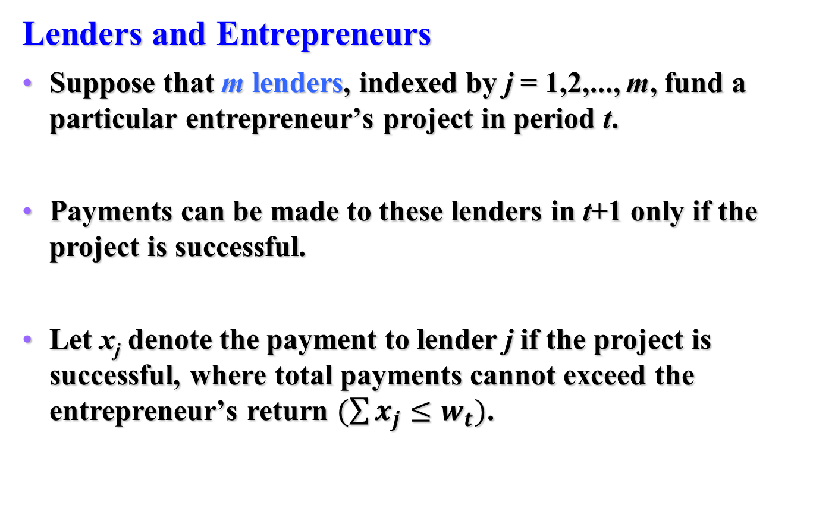
Delegated monitoring of borrowers
Lenders and Entrepreneurs
Suppose that m lenders, indexed by j = 1,2,..., m, fund a particular entrepreneur’s project in period t.
Payments can be made to these lenders in t+1 only if the project is successful.
Let x_{j} denote the payment to lender j if the project is successful, where total payments cannot exceed the entrepreneur’s return $(\sum{x_{j}≤w_{t})}$.

Slide 11
Delegated monitoring of borrowers
Lenders and Entrepreneurs
At t+1 the entrepreneur can make either of two declarations: the project succeeded or the project failed.
A lender’s optimal strategy is to monitor only if the entrepreneur declares the project failed.
Given this monitoring strategy, the entrepreneur always reports the true outcome to all lenders.

Slide 12
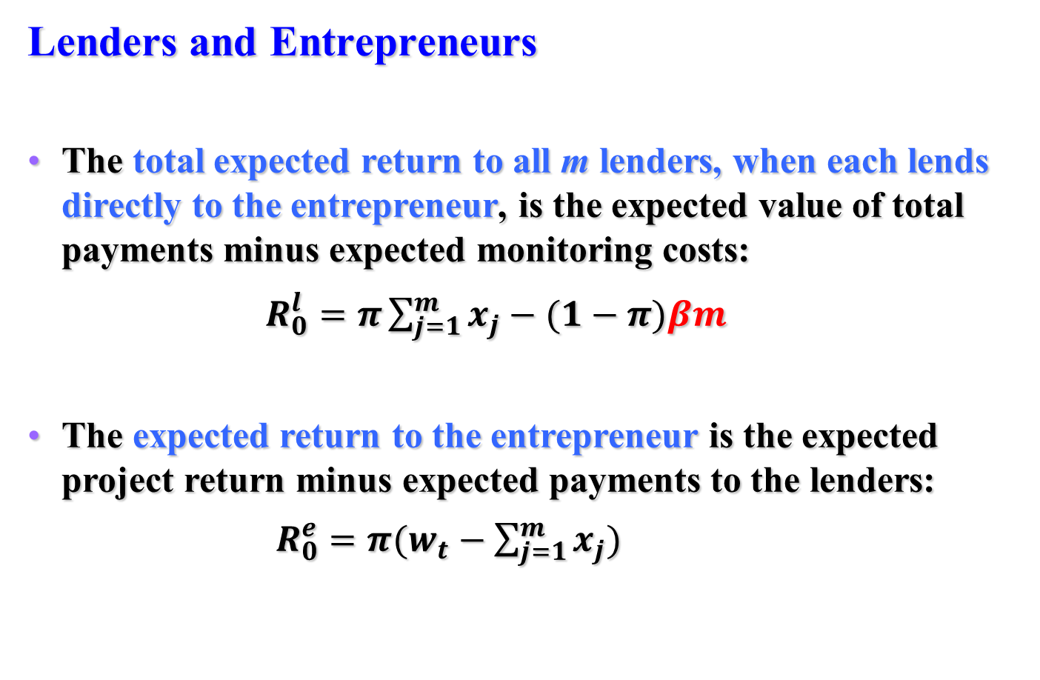
Delegated monitoring of borrowers
Lenders and Entrepreneurs
The total expected return to all m lenders, when each lends directly to the entrepreneur, is the expected value of total payments minus expected monitoring costs:
$R_{0}^{l}=π\sum_{j=1}^{m}{x_{j}−(1−π)βm}$
The expected return to the entrepreneur is the expected project return minus expected payments to the lenders:
$R_{0}^{e}=π(w_{t}−\sum_{j=1}^{m}{x_{j})}$

Slide 13
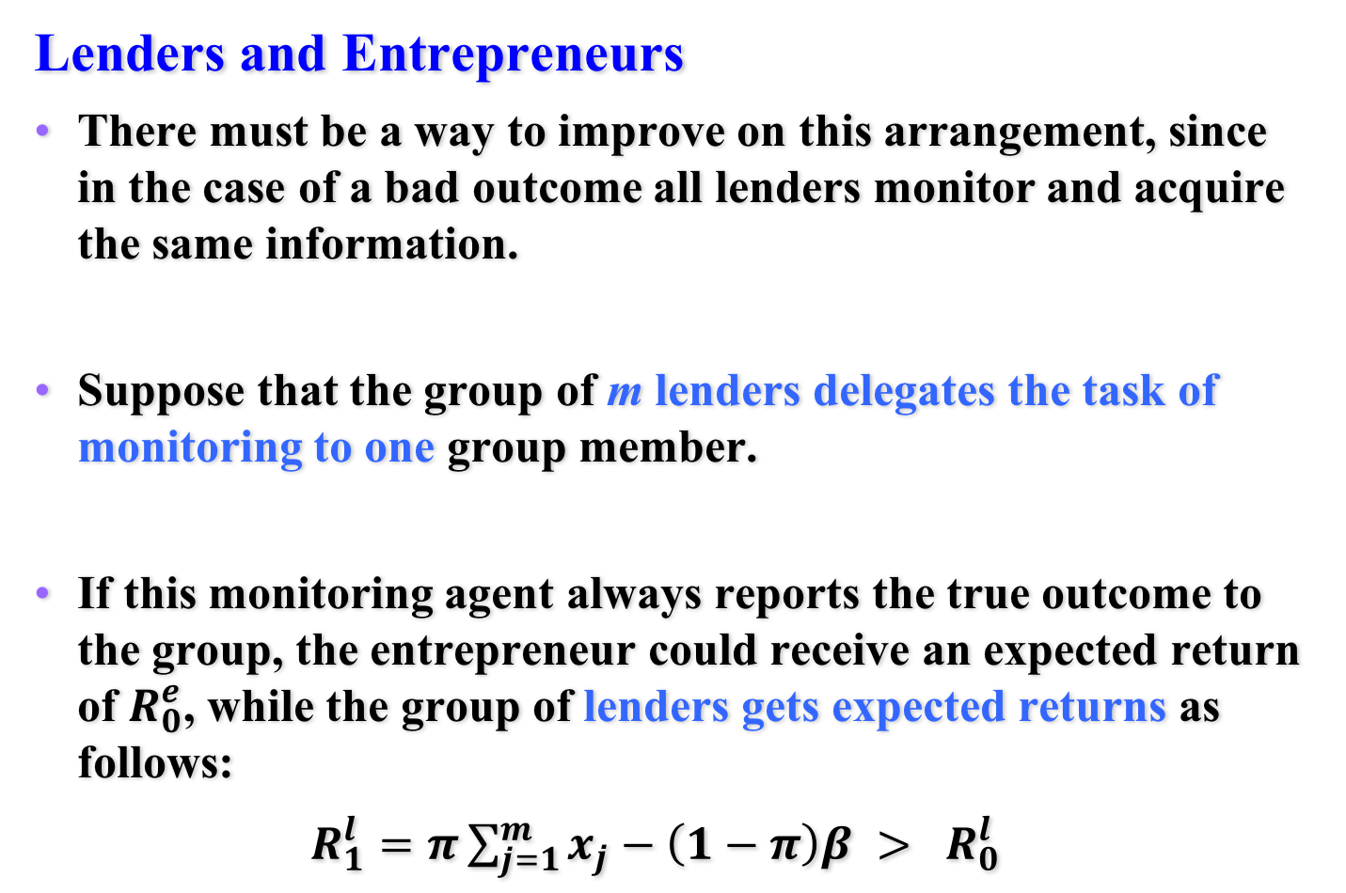
Delegated monitoring of borrowers
Lenders and Entrepreneurs
There must be a way to improve on this arrangement, since in the case of a bad outcome all lenders monitor and acquire the same information.
Suppose that the group of m lenders delegates the task of monitoring to one group member.
If this monitoring agent always reports the true outcome to the group, the entrepreneur could receive an expected return of $R_{0}^{e}$, while the group of lenders gets expected returns as follows:
$R_{1}^{l}=π\sum_{j=1}^{m}{x_{j}−\left(1−π\right)β > R_{0}^{l}}$

Slide 14
Delegated monitoring of borrowers
Lenders and Entrepreneurs
However, the moral hazard problem crops up again because the monitoring agent does not have an incentive to report the truth.
If the project succeeds, the monitoring agent could declare the outcome was bad and collude with the entrepreneur to split the payments that would have gone to the other lenders.

Slide 15
Delegated monitoring of borrowers
Financial intermediaries (FI)
An arrangement that optimally delegates the monitoring role does exist.
The FI is an individual lender (a monitoring agent) who lends to many entrepreneurs and borrows from many lenders.
By lending to and borrowing from many agents, the FI exploits the law of large numbers to perfectly predict the fractions of entrepreneurs with good and bad outcomes.

Slide 16
Delegated monitoring of borrowers
Financial intermediaries (FI)
The FI can therefore commit to making fixed payments to its depositors (lenders) without making the payments hinge on the outcomes of entrepreneurs’ projects.
In equilibrium, each depositor receives a certain return at t+1 of r_{t} per unit deposited in period t.
Because free entry into intermediation implies that no profit opportunities remain unexploited in equilibrium, FI’s earn zero profits.

Slide 17
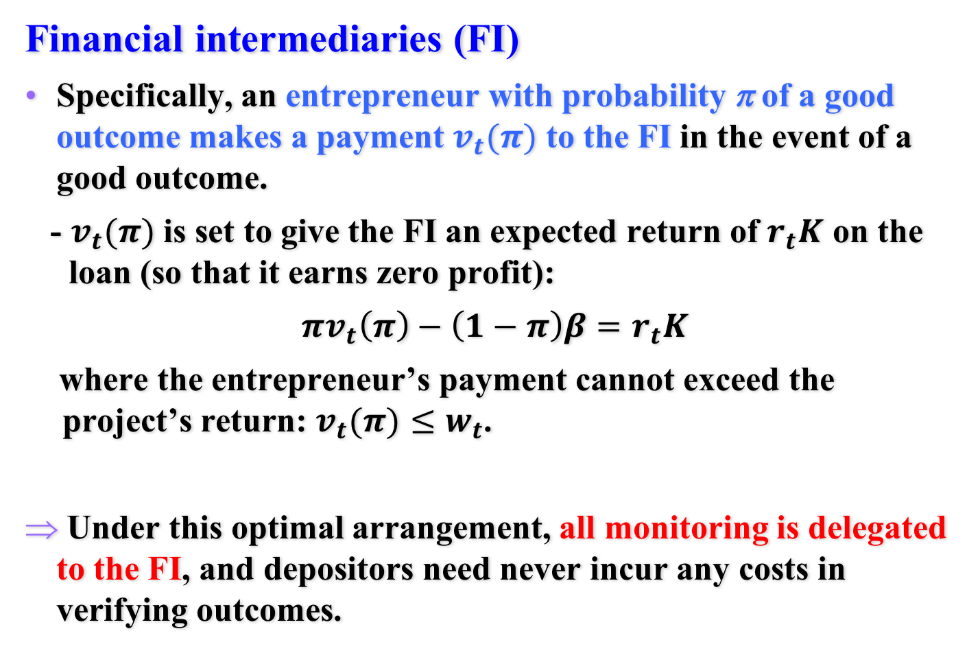
Delegated monitoring of borrowers
Financial intermediaries (FI)
Specifically, an entrepreneur with probability π of a good outcome makes a payment $v_{t}(π)$ to the FI in the event of a good outcome.
- $v_{t}(π)$ is set to give the FI an expected return of $r_{t}K$ on the loan (so that it earns zero profit):
$πv_{t}\left(π\right)−\left(1−π\right)β=r_{t}K$
where the entrepreneur’s payment cannot exceed the project’s return: $v_{t}(π)≤w_{t}$.
Under this optimal arrangement, all monitoring is delegated to the FI, and depositors need never incur any costs in verifying outcomes.

